Slide 1

19CSE312: Distributed Systems
Prenatal Health Monitoring System Using Fog Computing and Load Balancing
Richa Vivek Savant, S Navin Sunder, Spoorthi M
Department of Computer Science & Engineering,
Amrita School of Engineering, Bengaluru

Slide 2
Agenda
Motivation
Problem Statement
Introducing the iFogSim Platform
Proposed Topology
Background/ Literature Survey
Methodology
Results

Slide 3
Motivation
The shift towards continuous care places demands on long-term healthcare systems.
In regions with limited development individuals face challenges in accessing healthcare due to distance or cost associated with traveling to medical facilities.
Through the use of Internet of Things (IoT), e-health devices, and wearable technology, real-time tracking of an individual's health status can offer valuable insights, alarms, and alerts.
Conducting data processing closer to the point of origin can guarantee the security of sensitive information exchanged between patients and healthcare providers.
The low latency features facilitate real-time alerts, which can be crucial in scenarios like potential strokes.
Additionally, fog computing has the potential to minimize costs and alleviate bandwidth pressures by handling data near its origin, thereby reducing the volume sent to healthcare providers and stored in secure locations.

Slide 4
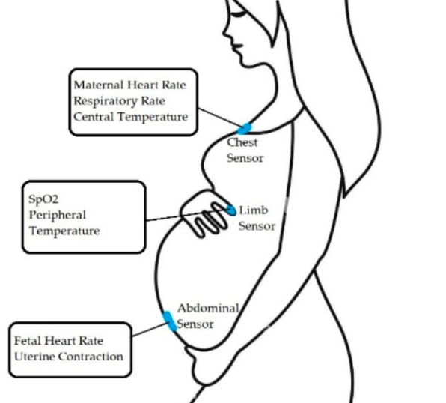
Motivation
Throughout pregnancy, a woman's health and the well-being of the fetus can be influenced by her lifestyle, behavior, and physical activities.
Consistent monitoring becomes essential, especially in the presence of potential risks or complications.
Pregnancy complications pose significant risks to both maternal and infant health, resulting in adverse outcomes like miscarriage, preterm birth, stillbirth, and low birth weight.
Many wearable sensors, m-health technologies, mobile apps, and other wireless devices have been developed to monitor both fetal and the mother’s health and physical activities and reduce risk during pregnancy.

Slide 5
Introducing the Problem Statement
A Prenatal Health Monitoring System using iFogSim, to record the following: 1. Heart rate 2. Temperature 3. Blood pressure
Problem Statement

Slide 6
iFogSim : Simulating Fog Computing Environments
iFogSim is a powerful simulation toolkit for Modeling and Simulation of Resource Management Techniques in Internet of Things, Edge and Fog Computing Environments.
Features/Characteristics:
- Graphical representation of the setup.
- Ability to reliably predict various parameters to monitor system performance.
- Enables the definition of infrastructure, service placement and optimization of resource allocation.
- It works on Sense- Process-Actuate application model.

Slide 7
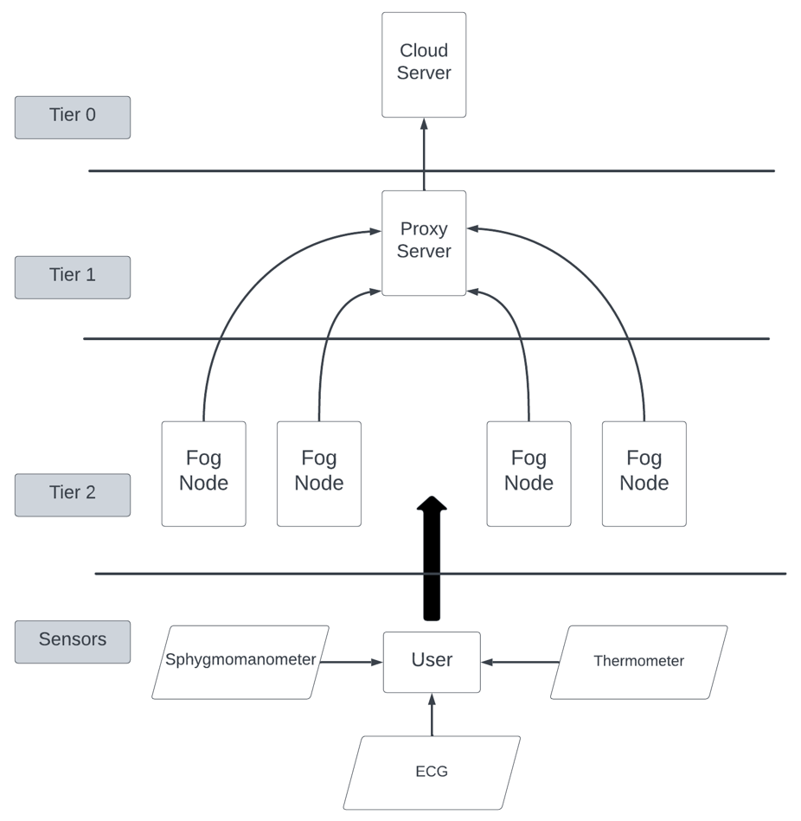
Proposed Topology

Slide 8
Literature Survey
Year | Paper Title | Authors | Abstract | Conclusion
2021 | Fog Based Architecture and Load Balancing Methodology for Health Monitoring Systems | Anam Asghar, Assad Abbas, Hasan Ali Khattak, Samee u. khan | The Paper talks about a fog-based architecture and Load Balancing Scheme (LBS) for health monitoring systems which are designed to reduce latency and improve network efficiency. Authors compare LBS with cloud-only and other fog-based methods, showing that it can decrease latency and network usage. They underline the importance of fog computing in terms of enhancing performance of health monitoring systems. | The conclusion of the study highlights Cloud computing cannot be used for health monitoring systems that need real-time responses because of the delay. Latency is reduced in fog computing by placing resources at the edge. For efficient data processing, load balancing between fog nodes is necessary. In order to enhance health monitoring systems, a new Load Balancing Scheme (LBS) was proposed and found to have better performance.
2022 | Software architecture for pervasive critical health monitoring system using fog computing | Abeera Ilyas, Mohammed Naif Alatawi, Yasir Hamid, Saeed Mahfooz , Islam Zada , Neelam Gohar, Mohd Asif Shah | This paper suggests Internet of Things (IoT) solution improves health monitoring by effectively identifying important streaming data, but it ignores latency and quality of service (QoS) issues. Load balancing provided by the fog-based architecture enhances latency performance and network use in healthcare systems. | With its integration of cloud and fog layers, the suggested hybrid architecture for IoT-based healthcare shows notable reductions in latency and network utilization. Future research may examine how blockchain technology and machine intelligence might be used to improve security for health monitoring data.

Slide 9
Literature Survey
Year | Paper Title | Authors | Abstract | Conclusion
2021 | Fog Computing in Healthcare: A Review | Kamini Pareek, Pradeep Kumar Tiwari, Vaibhav Bhatnagar | This paper is about Fog computing in healthcare is covered in the abstract, with particular attention paid to its ideas, design, and edge-to-edge comparison. It draws attention to the difficulties and solutions related to data security, privacy, and health monitoring in fog-enabled facilities. In order to improve health support and lower latency in healthcare applications, the research suggests using fog-based IoT systems. | The advantages of suggested fog-based architectures over conventional cloud-based systems in healthcare applications is emphasized in the conclusion. It emphasizes how fog computing may improve data security, lower latency, and improve the quality of services. The study promotes the use of fog computing to successfully address issues in healthcare systems.
2017 | Developing and Evaluating a Real time and Energy Efficient Architecture for An Internet of Health Things | Ahmad Malekian Borujeni, Mahmood Fathy, Nasser Mozayani | The health care sector uses IoT devices for the purpose of analyzing patient data. Processing modules analyze signals and update notifications. In order to improve patient satisfaction evaluations are done by comparing network metrics with healthcare apps’ Quality of Experience (QoE) which is very important. | In order to enhance care for patients, the study suggests a healthcare monitoring system that depends on the Internet of Things (IoT) and uses effective strategies for analyzing data as well as placement of applications. The aim of this research is to ensure better health services are offered by concentrating on patients’ satisfaction through optimization QoE while considering network metrics.

Slide 10
Literature Survey
Year | Paper Title | Authors | Abstract | Conclusion
2022 | Edge–Fog–Cloud Computing Hierarchy for Improving Performance and Security of NB-IoT-Based Health Monitoring Systems | Yousef-Awwad Daraghmi , Eman Yaser Daraghmi , Raed Daraghma , Hacène Fouchal, Marwane Ayaida | The paper explores a smart medical system utilizing NB-IoT technology, focusing on reducing delay and enhancing authentication protocols. It proposes a hierarchical architecture with Edge, Fog, and Cloud layers for remote health monitoring, demonstrating improved performance and efficiency. | The paper concludes that the proposed three-layer architecture utilizing NB-IoT technology for remote health monitoring significantly reduces delay and execution time while enhancing security through efficient authentication protocols. The Light-Edge protocol stands out as the most effective option for optimizing computation time and transmission delay across the system layers.
2022 | Design of Fog Based Remote Health Monitoring System | Gopinath A R, Dr. Yash Pal Singh, Dr. Navanath S Narawade | The architecture for the Remote Healthcare Monitoring (RHM) system, which uses fog computing to provide real-time Internet of Things services, is presented in this study. It leverages local decision-making for fog computing benefits and combines body sensors and cameras for health issue diagnosis. In order to provide a safe and dependable medical infrastructure, the system seeks to improve overall system intelligence, energy efficiency, network usage, and reaction times. | The advantages of a fog/cloud-based Remote Healthcare Monitoring (RHM) system—which integrates wearable sensors with cameras for improved health diagnostics and uses fog computing for real-time IoT services—are highlighted in the paper's conclusion. It emphasizes the significance of data security using encryption and watermarking techniques. In terms of healthcare monitoring, the RHM system provides faster reaction times, lower network use, increased system intelligence, and energy economy.

Slide 11
Literature Survey
Year | Paper Title | Authors | Abstract | Conclusion
2022 | Internet of Health Things: A Fog computing Paradigm | Aiswarya S, K.Ramesh, Sasikumar S, D Sheema, Prabha B | The paper proposes a three-tier architecture with enhanced fog computing to address latency issues in healthcare IoT. It integrates fuzzy logic and reinforcement learning to reduce network latency and improve traditional cloud computing techniques. The work aims to enhance present healthcare IoT systems by minimizing network usage, computation, and communication latency through virtualization and machine learning. | The conclusion emphasizes the benefits of the proposed three-tier fog computing architecture in improving healthcare IoT systems by reducing network latency. Challenges such as interoperability, data security, and node agility need to be addressed for successful fog architecture development. Leveraging IoT capabilities with fog computing in healthcare can significantly impact patient care.
2021 | Fog-based Remote in-Home Health Monitoring Framework | Fatma H. Elgendy, Amany M. Sarhan, Mahmoud A. M. Alshewimy | The Remote in-Home Health Monitoring (RHHM) framework, which makes use of fog computing to monitor patients, is introduced in the abstract. In order to assess medical issues, alert caregivers to crises, and store encrypted data locally, it integrates sensors, cameras, and data analysis. Comparing the framework to conventional cloud-based systems, the goal is to increase efficiency and decrease latency. | In comparison to cloud-based solutions, the efficacy of the fog-based framework for remote pain monitoring is highlighted in the conclusion. It highlights the advantages of the suggested architecture by talking about improvements in reaction time, energy consumption, latency, and network utilization. Simulation findings validate the fog-based approach's efficacy in healthcare surveillance.

Slide 12
Literature Survey
Year | Paper Title | Authors | Abstract | Conclusion
2021 | A novel fog‑computing‑assisted architecture of E‑healthcare system for pregnant women | Rydhm Beri, Mithilesh K. Dubey, Anita Gehlot, Rajesh Singh, Mohammed Abd‑Elnaby, Aman Singh | A novel fog computing system is developed for monitoring pregnant women's health, integrating IoT sensors, fog nodes, and cloud servers for efficient data processing. With a high accuracy rate of 98.75%, the system provides health recommendations and real-time monitoring, ensuring secure data transmission and authentication. It offers immediate alerts for potential health issues, proving effective in enhancing healthcare outcomes for pregnant women compared to existing studies. | An E-healthcare system for pregnant women uses fog computing for real-time monitoring and alerts, integrating IoT sensors, fog nodes, and cloud servers. It prioritizes secure data transmission, authentication, and immediate alerts for health issues, showing efficiency in improving healthcare outcomes.
2021 | IOT Based Pregnancy Women Health Monitoring System for Prenatal Care | B.Priyanka, Kalaivanan.V.M, Pavish.R.A , Kanageshwaran.M | The study highlights the paucity of medical information sharing in rural locations, which poses a difficulty to pregnant women's prenatal care. It presents an Internet of Things (IoT) system that monitors the health of mothers by employing sensors such as blood pressure, temperature, heart rate, and accelerometers. By delivering real-time health data with ARDUINO UNO and IOT technologies, the system seeks to improve prenatal care and possibly lower maternal death rates. | Using a microcontroller, the device effectively tracks vital indications such as temperature, fetal kick count, heart rate, and pulse rate. Anomalies set up alarms that require quick attention. By using IOT, the system efficiently sends data to a smartphone application, allowing for remote monitoring and maybe leading to better maternal health outcomes.

Slide 13
Software Requirements
HARDWARE:
Processor: Intel Core i3 or more.
RAM: 4GB or more.
Hard disk: 256 GB or more.
SOFTWARE:
Operating System: Windows 10, 7, 8.
IDE: Eclipse IDE
Java Version: jdk 1.8
Additional Libraries:
Cloudsim-3.0.3.jar
Cloudsim-3.0.3-sources.jar
Cloudsim-examples-3.0.3.jar
Cloudsim-examples-3.0.3-sources.jar
Commons-math3-3.5.jar
Guava-18.0.jar
Json-simple-1.1.1.jar

Slide 14
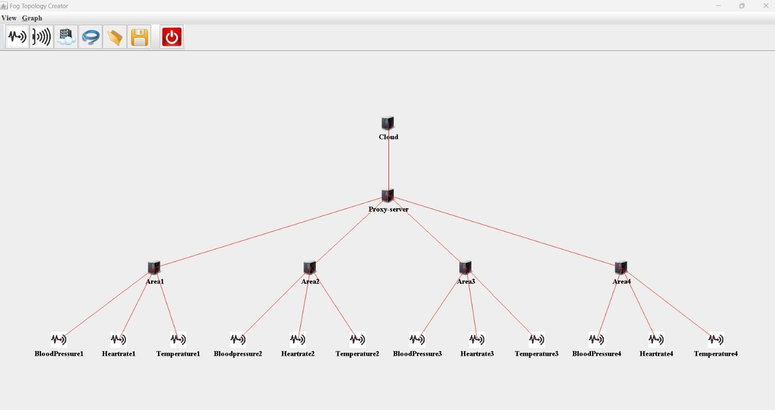
SCENARIO 1 TOPOLOGY

Slide 15
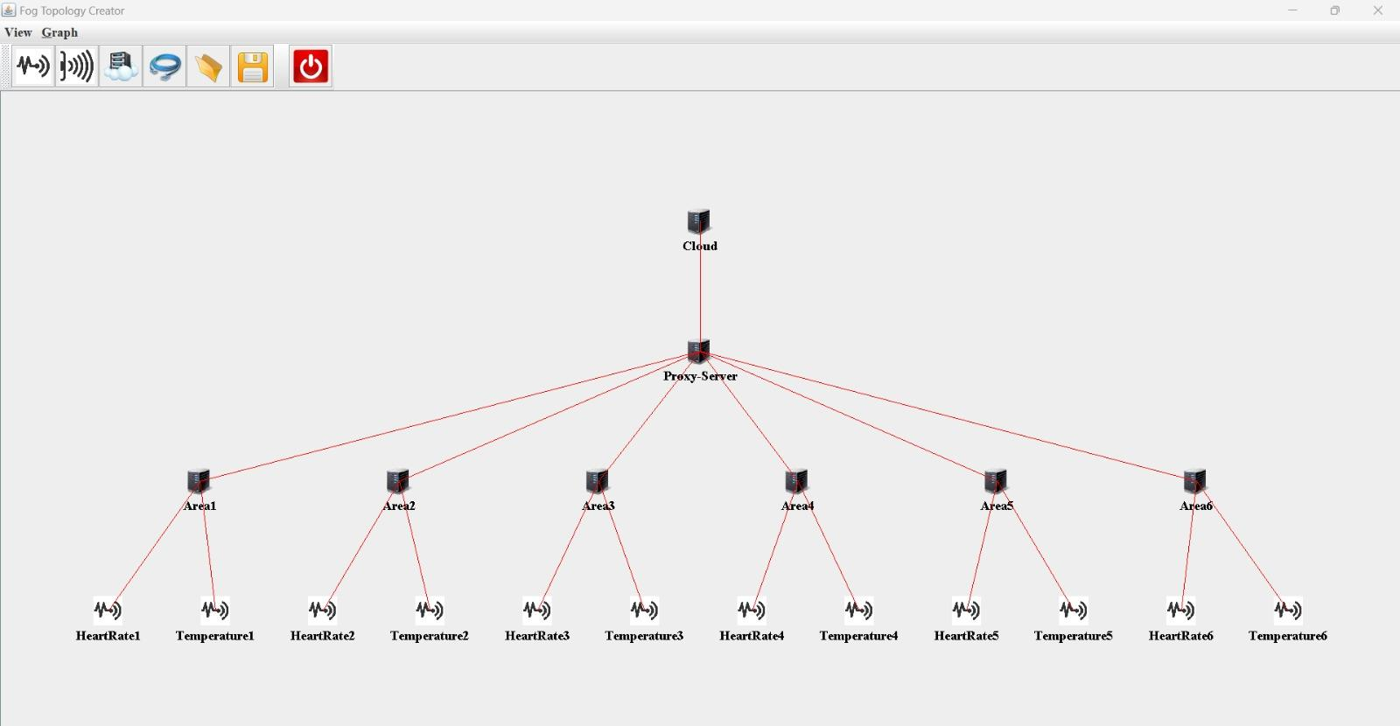
SCENARIO 2 TOPOLOGY

Slide 16
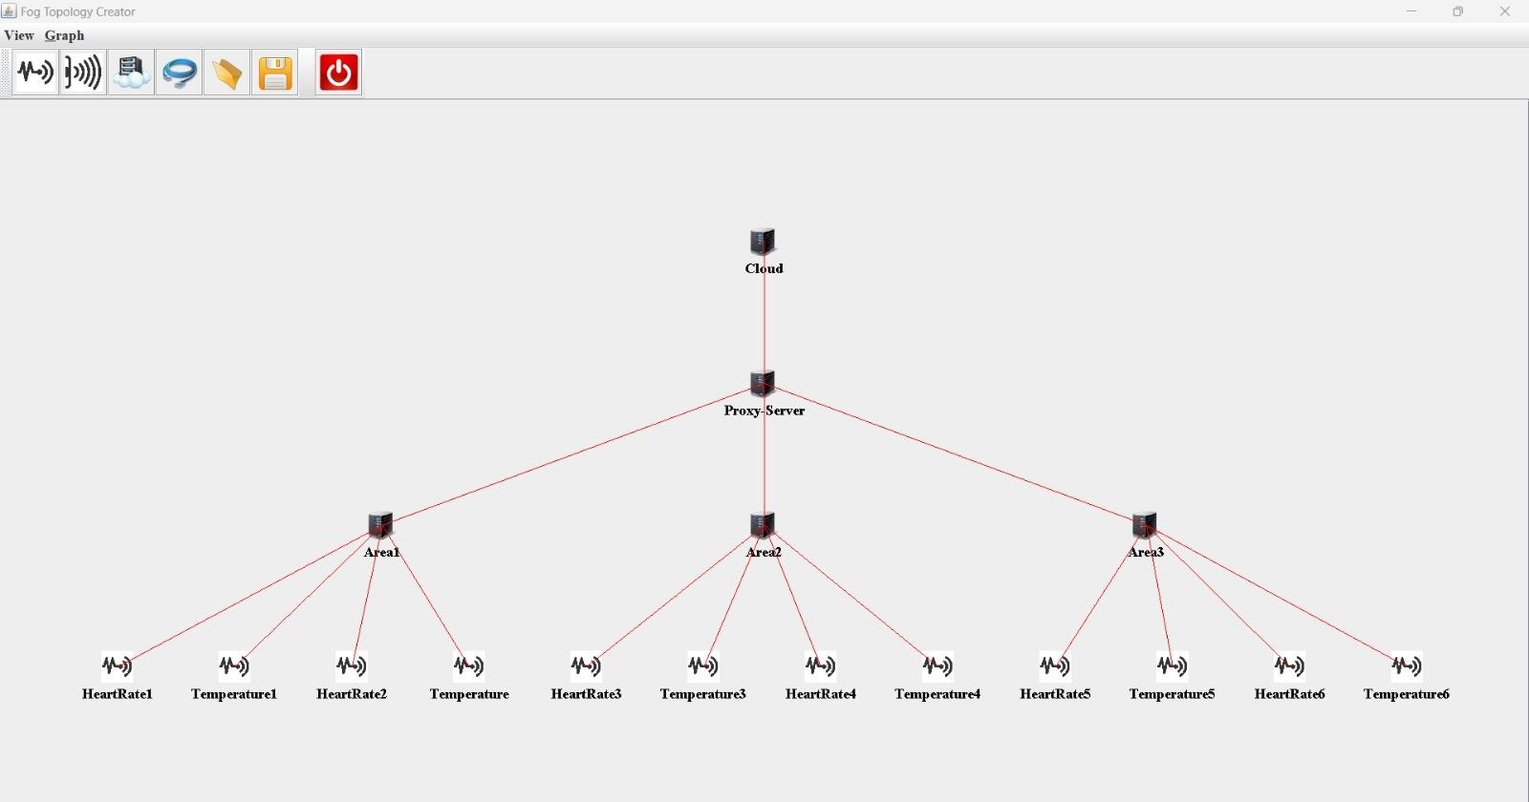
SCENARIO 3 TOPOLOGY

Slide 17
Methodology
Define requirements of the system: key parameters to monitor - Blood pressure, Temperature, Heart rate
Model the fog computing architecture: design the basic topology of the fog devices to include at every tier, define characteristics and behaviours for every device (sensor, server, cloud, etc.).
Select simulation tool => iFogSim
Develop Simulation Scenarios:
Create simulation scenarios that represent real-world healthcare scenarios for pregnant women. Define factors such as the number of pregnant women being monitored, their locations, and the frequency of health parameter readings.

Slide 18
Methodology
Implement communication models: to simulate data transmission between IoT devices, fog nodes, and cloud servers (network latency, bandwidth, etc. values need to be defined for the respective sensor)
Run Simulations and Analyze Results:
performance metrics: response time, throughput, and resource utilization.
Optimize and Refine:
Iterate on the simulation design, adjusting parameters as needed to optimize the performance of the smart healthcare system and the total energy consumed.

Slide 19
Methodology
Efficient Fog Design: The topology designed is now implemented in the iFogSim environment
Key Fog Device Characteristics: Fog devices are defined with processing power (MIPS), storage (RAM), bandwidth, and hierarchical level.
Network Hierarchy: The network includes cloud (tier 0), proxy server (tier 1), area fog nodes (tier 2), and sensor fog devices.
Load balancing policies in iFogSim:
ModulePlacementMapping,
ModulePlacementEdgewards,
ModulePlacementOnlyCloud,
ModulePlacementGreedy

Slide 20
Methodology
Module Placement Policy: The system utilizes Module Placement Edgewards (MPE) for:
real-time processing,
reduced network load,
potential privacy benefits.
MPE prioritizes processing closer to sensors (edge devices) for faster analysis and decision-making.
This approach minimizes data transmission latency and network congestion.
Edge processing may also offer some privacy advantages.

Slide 21
Results
Three Fog Topologies Evaluated:
Scenario 1: 4 areas with 3 sensors each (ECG, thermometer, sphygmomanometer)
Scenario 2: 6 areas with 2 sensors each (ECG, thermometer)
Scenario 3: 3 areas with 4 sensors each (2 ECGs, 2 thermometers)
Key Performance Indicators (KPIs):
Energy consumption at each node
Total execution time for simulation
Optimal Topology: Scenario 1
Achieved balance between:
Lower energy consumption compared to Scenarios 2 & 3
Faster execution time compared to Scenarios 2 & 3

Slide 22
Results
Drawbacks of Other Scenarios:
Scenario 2: Increased execution time due to more fog nodes
Scenario 3: Higher energy consumption compared to Scenario 1
Impact of High Energy Consumption:
Increased operational costs
Reduced sustainability
Energy management challenges (thermal throttling)
Impact of High Execution Time:
Delay in making decisions
Reduced system throughput
Increased network latency
Overall impact on the system:
Degraded system performance
Limited scalability
Decreased user experience (delays, outages)

Slide 23
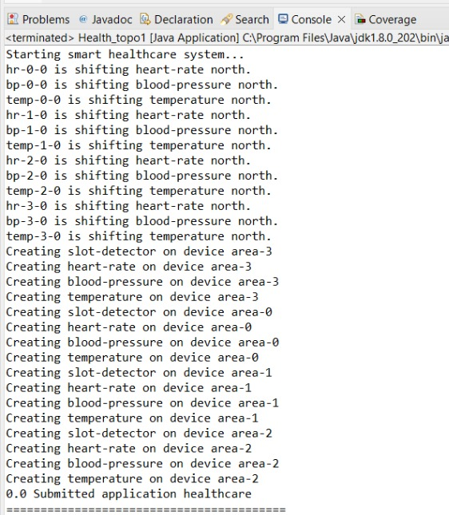
Results
Scenario 1:

Slide 24
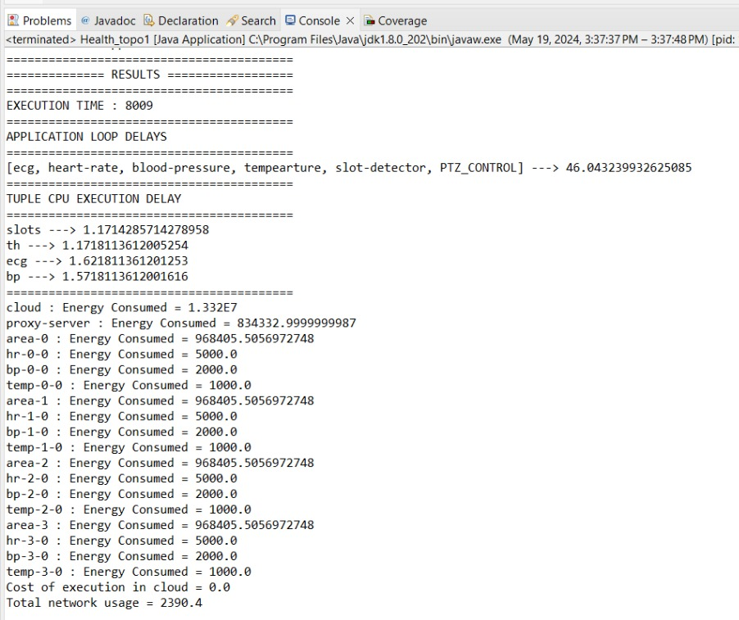
Results
Scenario 1:

Slide 25
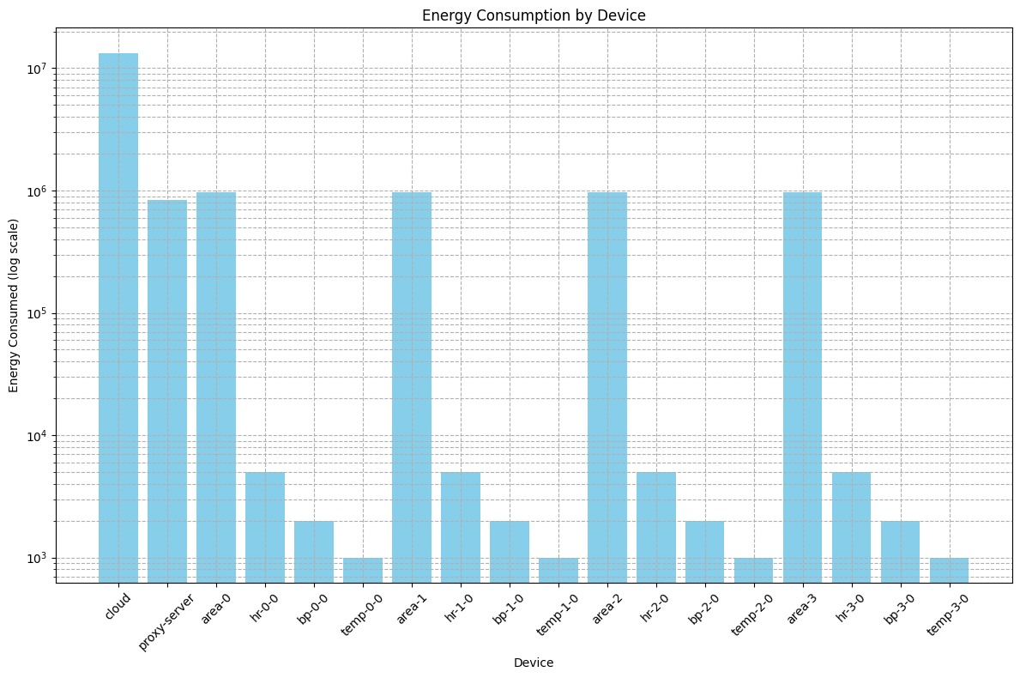
Results
Scenario 1:

Slide 26
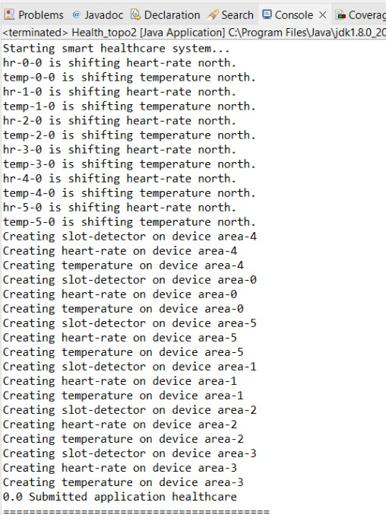
Results
Scenario 2:

Slide 27
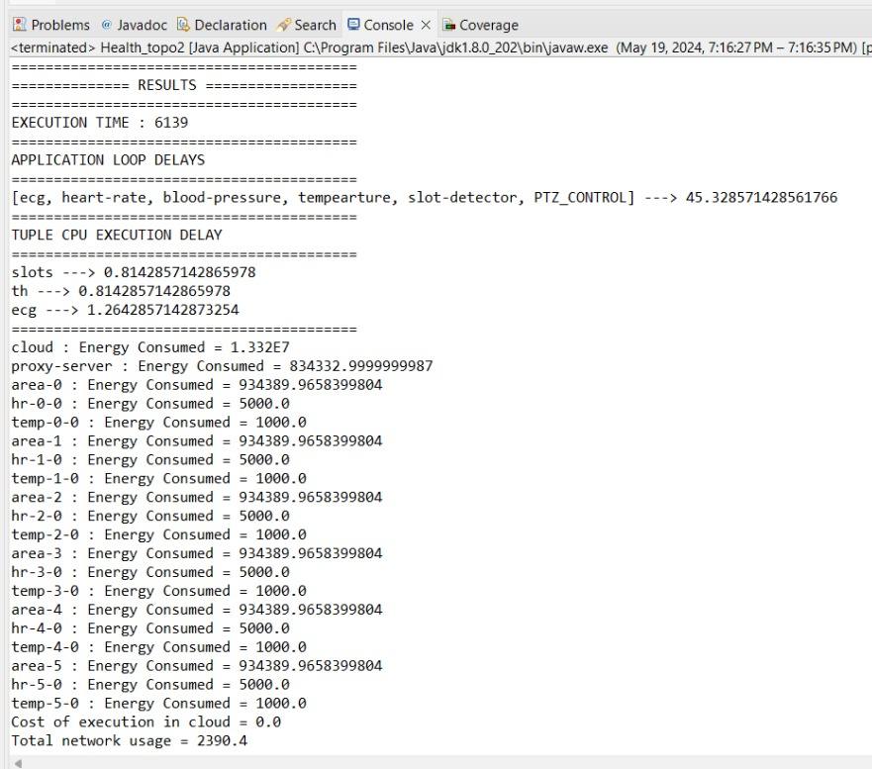
Results
Scenario 2:

Slide 28
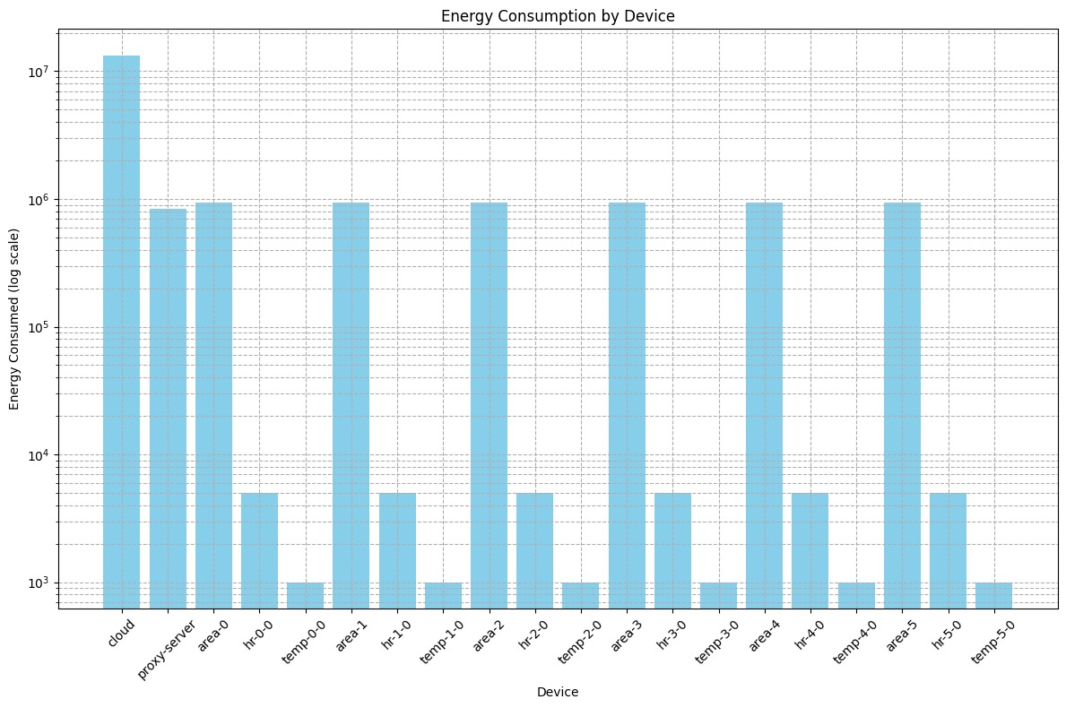
Results
Scenario 2:

Slide 29
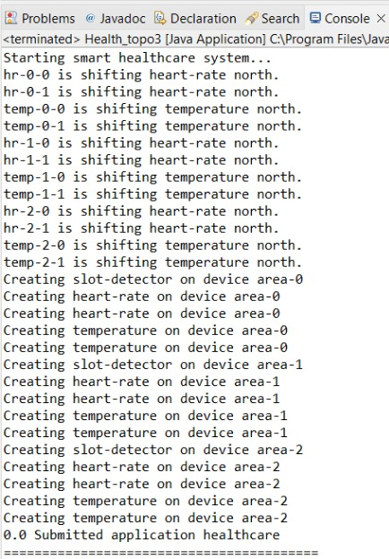
Results
Scenario 3:

Slide 30
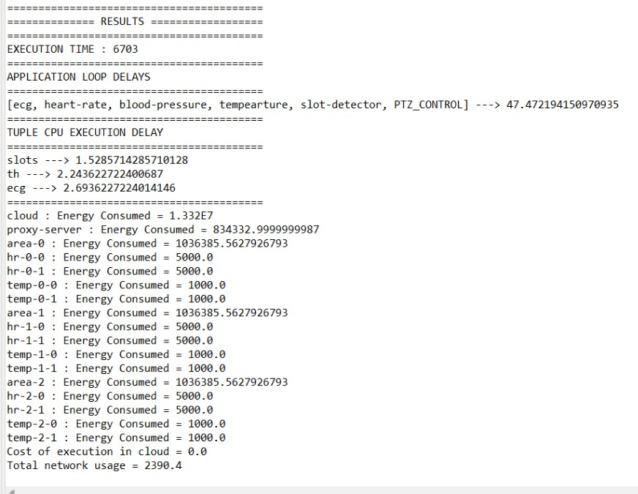
Results
Scenario 3:

Slide 31
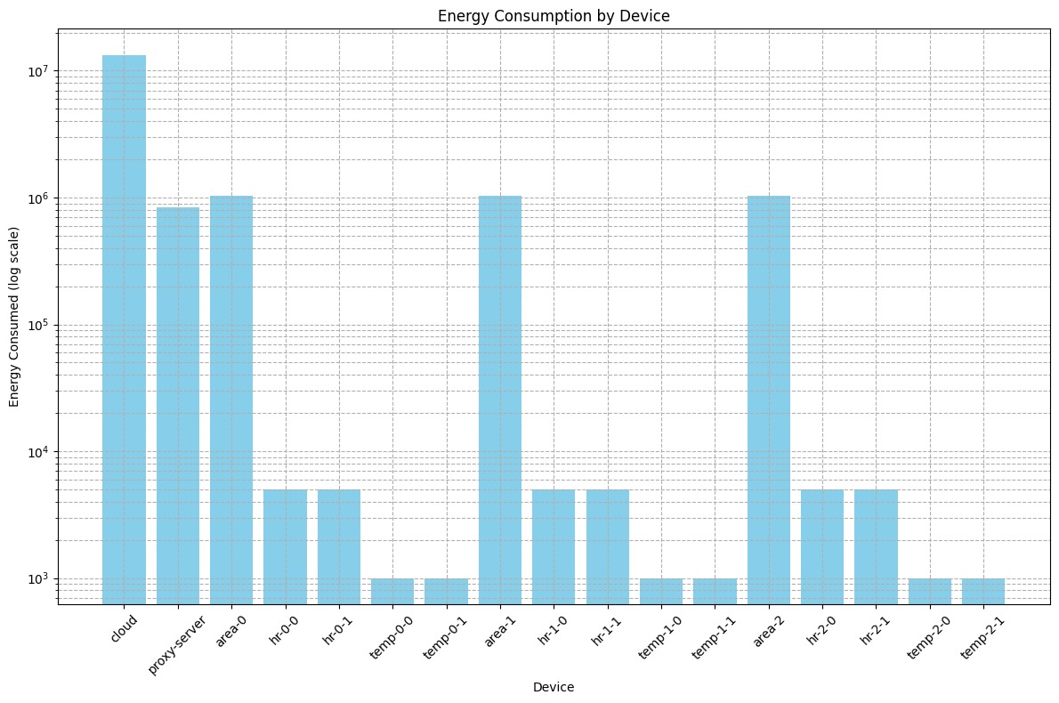
Results
Scenario 3:

Slide 32
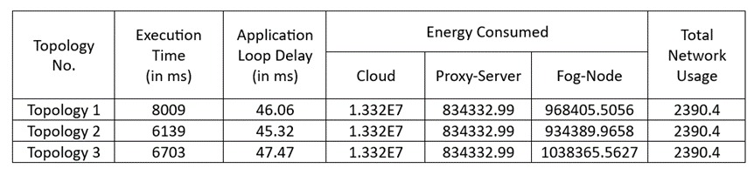
Results
Comparison of evaluation metrics for all the three scenarios considered:

Slide 33
Conclusion
Monitoring energy consumption and execution time for the three scenarios resulted in the following observations:
Scenario 1: The Ideal Choice
Minimizes energy consumption on fog devices
Achieves faster execution times, enabling real-time data processing
Reduces network latency and improves system throughput.
Drawbacks of Other Scenarios:
Scenario 2: Increased execution time due to more fog nodes, leading to delays and lower throughput.
Scenario 3: High energy consumption compared to Scenario 1, resulting in higher costs and sustainability concerns.

Slide 34
Conclusion
Aligns with iFogSim's principles of sustainability by minimizing carbon footprint.
Enables real-time processing for critical healthcare decisions.
Offers a scalable and high-performing fog computing solution.
FUTURE WORK:
Add more sensors to each fog node and optimise the network performance by designing an appropriate topology that accommodates more sensors and ensures scalability, sustainability and high throughput.

Slide 35
Thank you!

